Slide 1
Data Science and Machine Learning
Introduction

Slide 2
Data is: Big!
Lots of Data => Lots of Analysis => Lots of Jobs
2.5 quintillion (10¹⁸) bytes of data are generated every day!
Everything around you collects/generates data (about 87 % of websites)
Social media sites
Business transactions
Location-based data
Sensors
Digital photos, videos
Consumer behaviour (online and store transactions)
More data is publicly available
Database technology is advancing
Cloud based & mobile applications are widespread
Source: IBM http://www-01.ibm.com/software/data/bigdata/

Slide 3
If I have data, I will know :)
Everyone wants better predictability, forecasting, customer satisfaction, market differentiation, prevention, great user experience, ...
How can I price a particular product?
What can I recommend online customers to buy after buying X, Y or Z?
How can we discover market segments? group customers into market segments?
What customer will buy in the upcoming holiday season? (what to stock?)
What is the price point for customer retention for subscriptions?

Slide 4
Data Science is: making sense of Data
Lots of Data => Lots of Analysis => Lots of Jobs
Multidisciplinary study of data collections for analysis, prediction, learning and prevention.
Utilized in a wide variety of industries.
Involves both structured or unstructured data sources.

Slide 5
Data Science is: multidisciplinary
Statisticians
Mathematicians
Computer Scientists in
Data mining
Artificial Intelligence & Machine Learning
Systems Development and Integration
Database development
Analytics
Domain Experts
Medical experts
Geneticists
Finance, Business, Economy experts
etc.

Slide 6
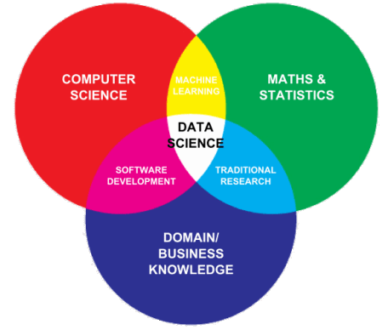
Data Science is: multidisciplinary
Statisticians
Mathematicians
Computer Scientists in
Data mining
Artificial Intelligence & Machine Learning
Systems Development and Integration
Database development
Analytics
Domain Experts
Medical experts
Geneticists
Finance, Business, Economy experts
etc.

Slide 7
Data Science is: about the whole processing pipeline to extract information out of data
Data Scientist understand and care about the whole data pipeline:
A data pipeline consists of 3 steps:
Preparing to run a model: Gathering, cleaning, integrating, restructuring, transforming, loading, filtering, deleting, combining, merging, verifying, extracting, shaping
Running the model
Communicating the results

Slide 8
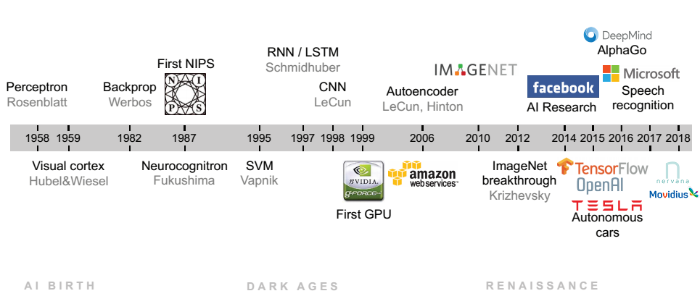
AI
LeCun et all. SIAM 2018

Slide 9

AI zoo

Slide 10
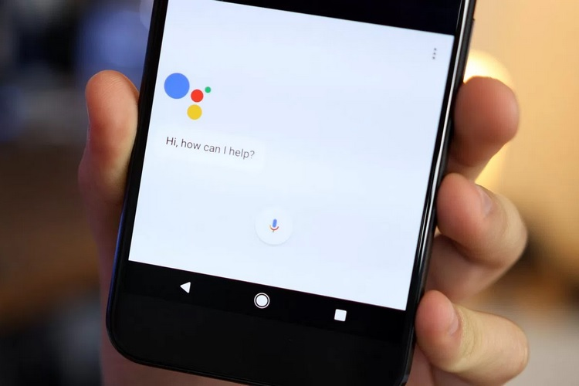

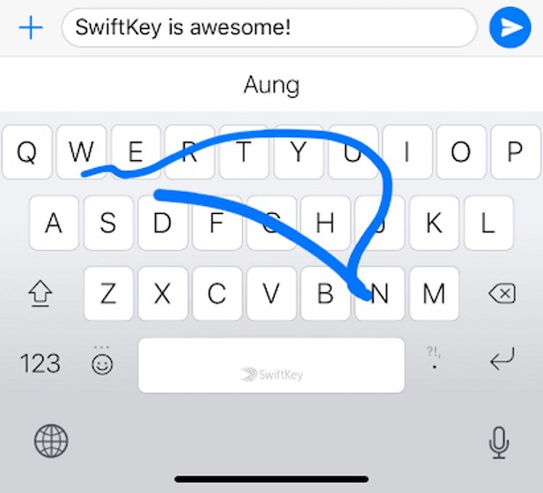
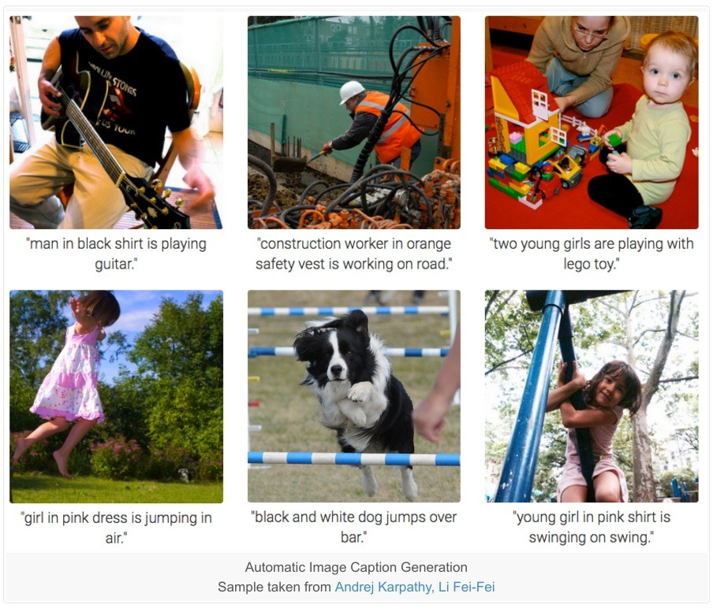
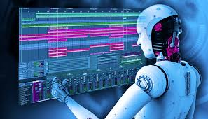

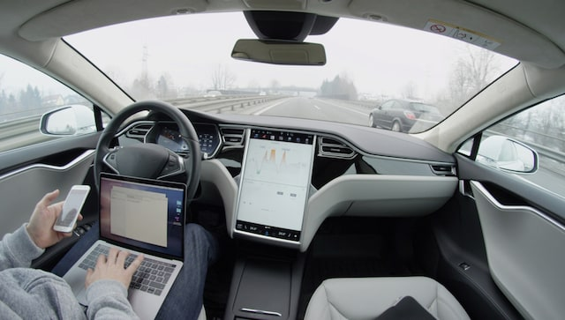




Data Science Success

Slide 11

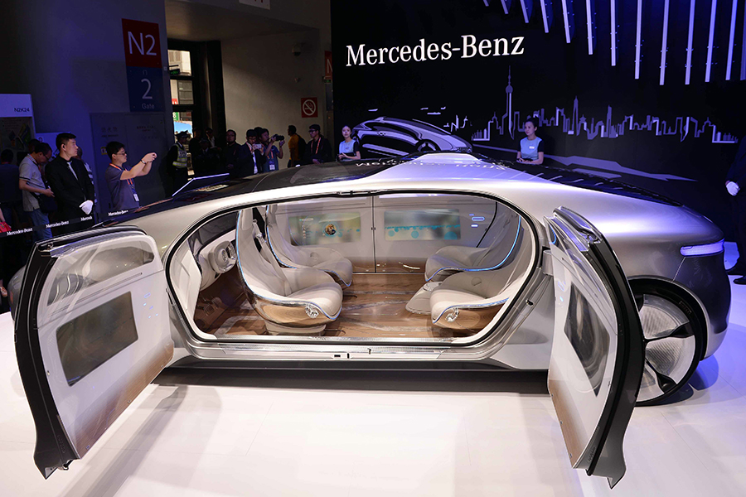
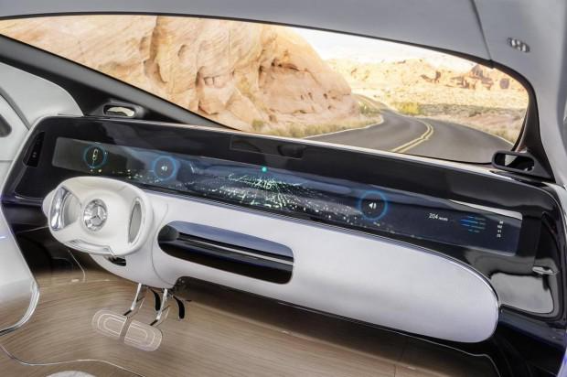
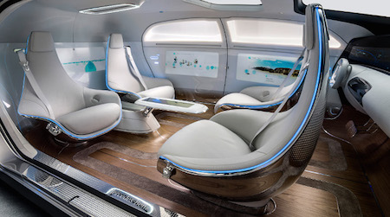
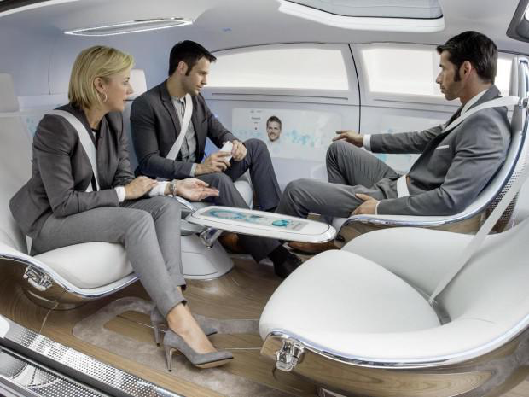
Mercedes-Benz Autonomous Car Interior Concept (Luxury F 015)
Notes:
Bandes dessinée ou dans les films science fiction : on conduit plut mais on discute et on partage et on prend du cafe

Slide 12
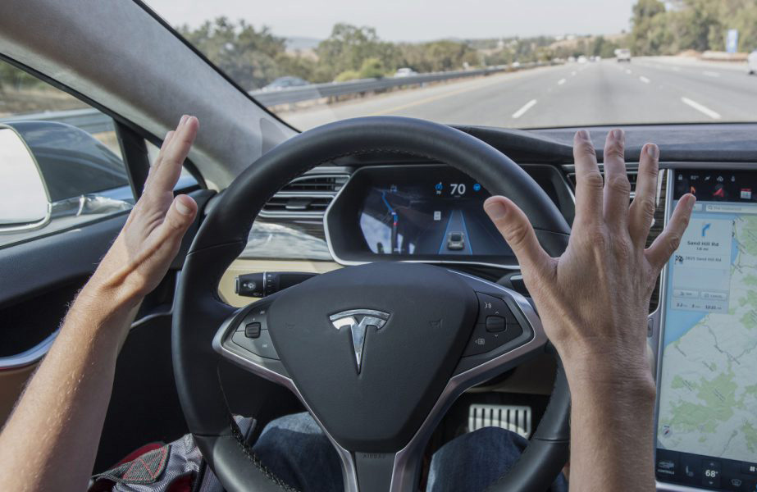
“We really designed the Model S to be a very sophisticated computer on wheels. Tesla is a software company as much as it is a hardware company. A huge part of what Tesla is, is a Silicon Valley software company. We view this the same as updating your phone or your laptop.”
“Full autonomy is really a software limitation: The hardware exists to create full autonomy, so it’s really about developing advanced, narrow AI for the car to operate on” Elon Musk

Slide 13
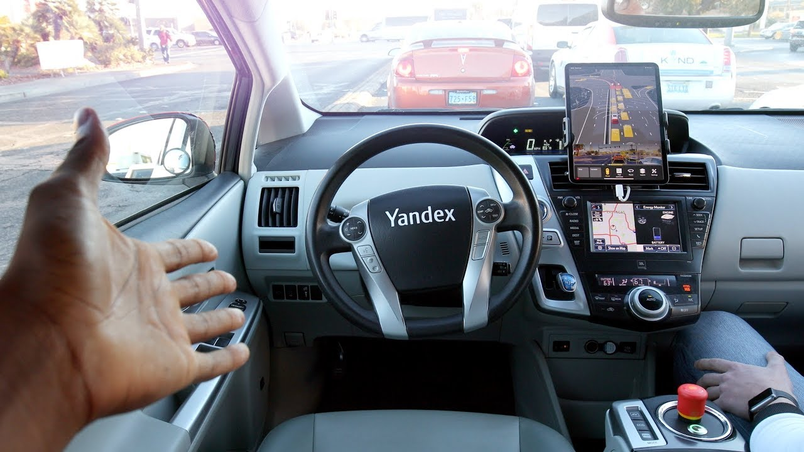
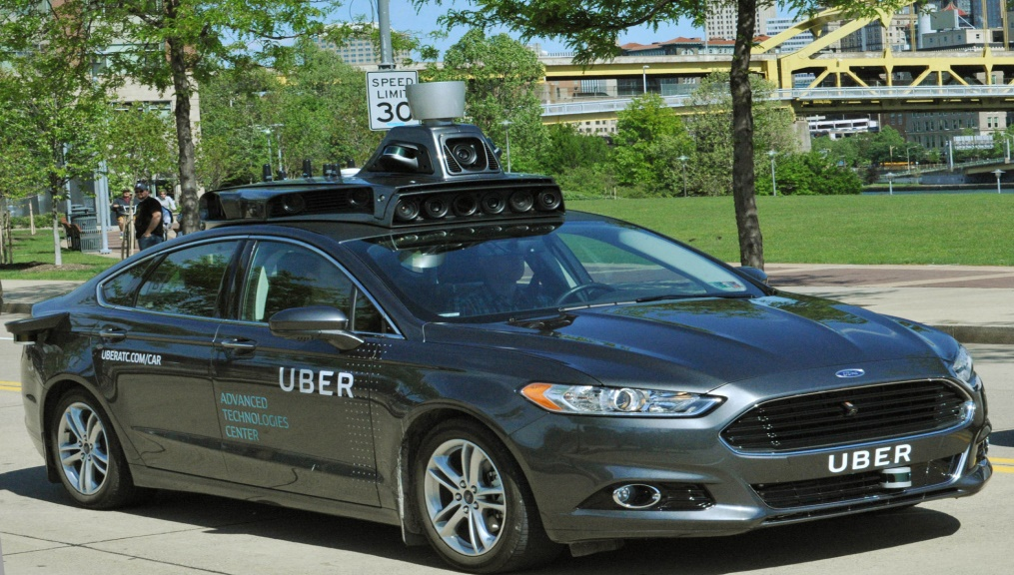
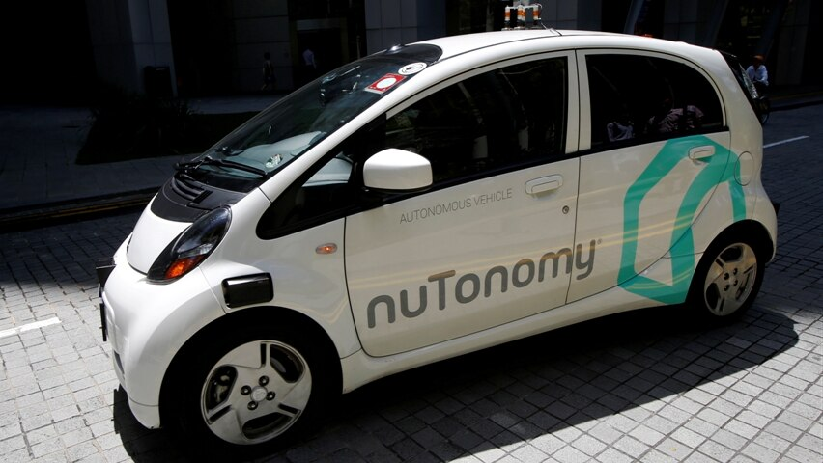


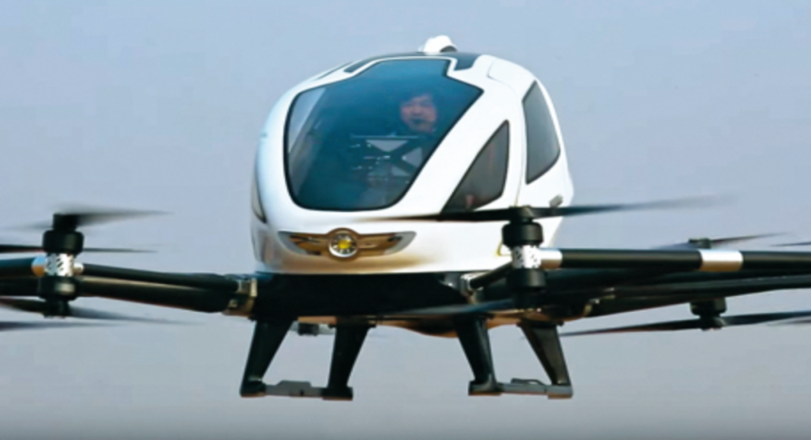
Notes:
Waymo is an autonomous car development company spun out of Google's parent company, Alphabet Inc in december 2016. It then took over the self-driving car project which Google had begun in 2009.
Electric autonomous passenger drone: Boeing, Airbus, China
The 2017 version of their car called the Pacifica minivan as shown in the figure and considered the most advanced self-driving car to date.
You may ask why, well apparently, Google toke good care training those new prototypes, in fact they were trained over roughly 3 million miles of real-world driving using data gathered from their own sensors , and in the last year alone they’ve completed one billion miles of testing in simulation.
To reach what the Society of Automotive Engineers classify as Level 4 autonomy , they built all of their self-driving sensors from the ground up, which not only made their prototype safer and reliable, but considerably cheaper, we’re talking about going from 75k to 7,5k per sensor only in LiDAR case. It still a high cost, but much better than before

Slide 14
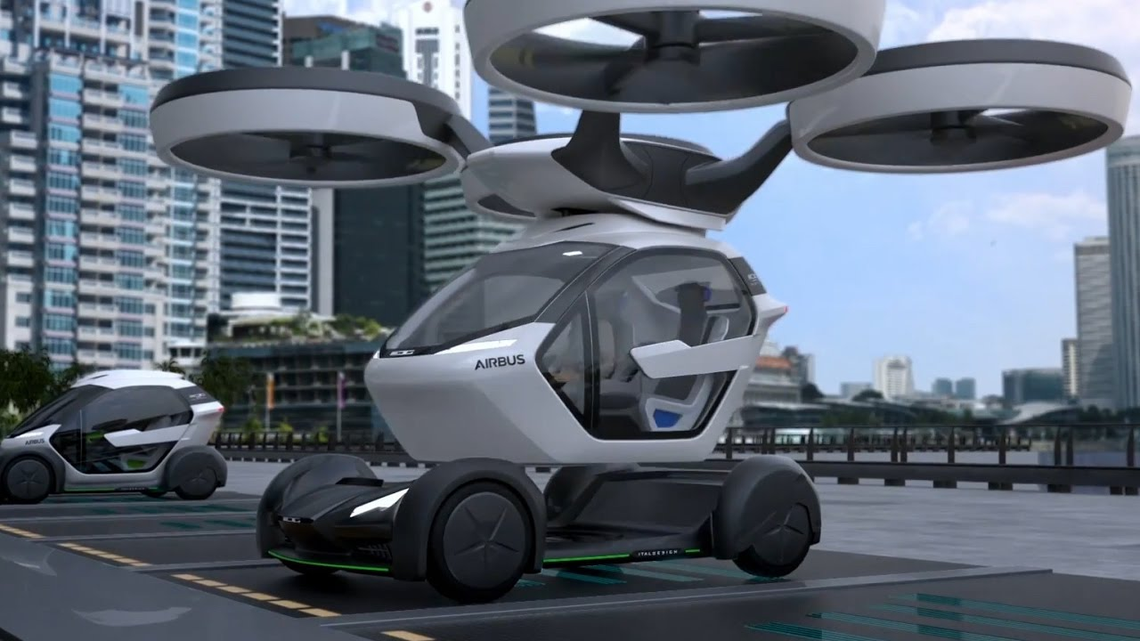
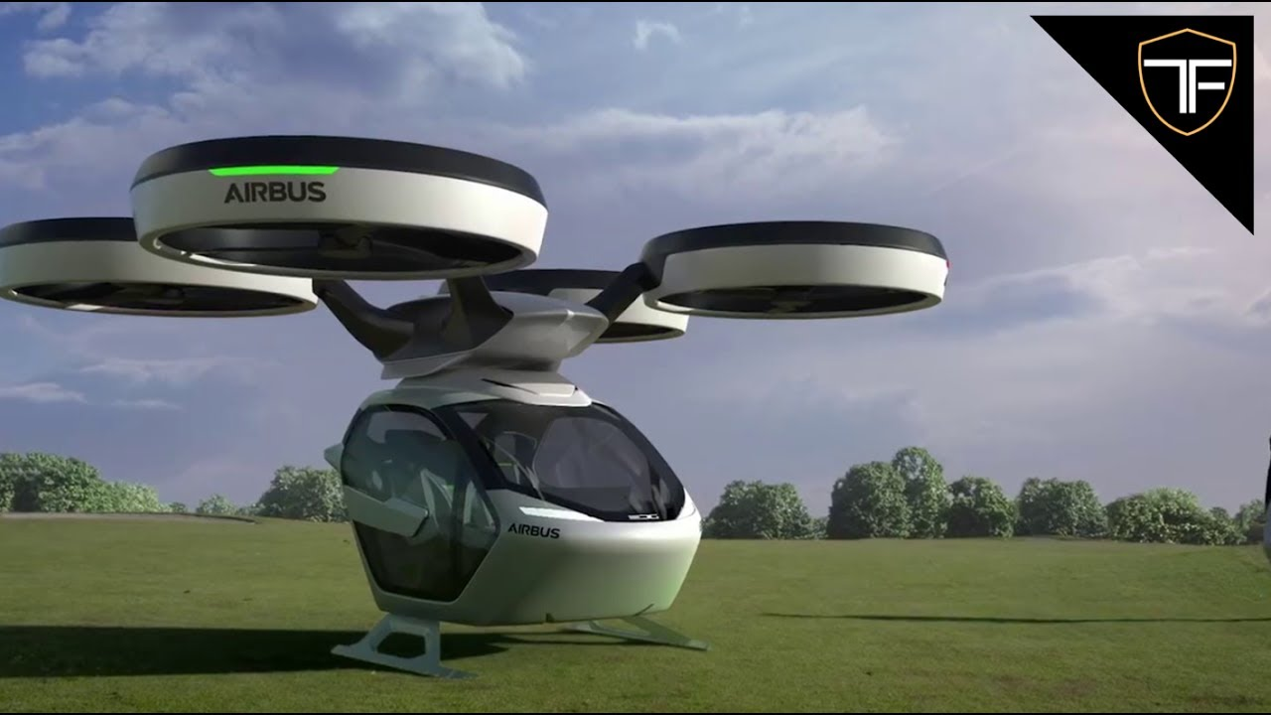

Slide 15
Data Science Principals
Data Science is a process
ML is optimization of loss functions
ML must generalize to unseen data
Evaluate data science in its operational context
Similar entities can have similar unseen attributes
Correlation, not causation

Slide 16
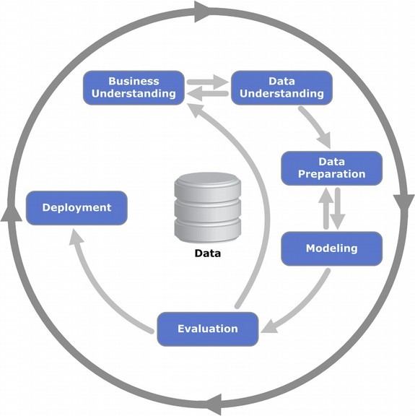
P1: Data Science is a process
Cross-industry standard process for data mining, known as CRISP-DM, is an open standard process model that describes common approaches used by data mining experts.
It is the most widely-used analytics model

Slide 17
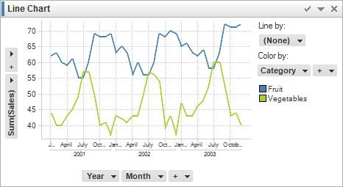
P1: Data Science is a process A simple workflow from a technical PoV
Plan
Clean Data
What is the question?
Data Quality Analysis
Reformating & Imputing Data
Start
Data Acquisition
What type of data is needed?
Scripts
Explore the Data
Feature
Deployment
Feature Selection
Model Selection
Results Evaluation
Maintenance
Engineering
Scripts
Optimization
Scripts
Data Analysis
Modeling
Deployment and optimization

Slide 18
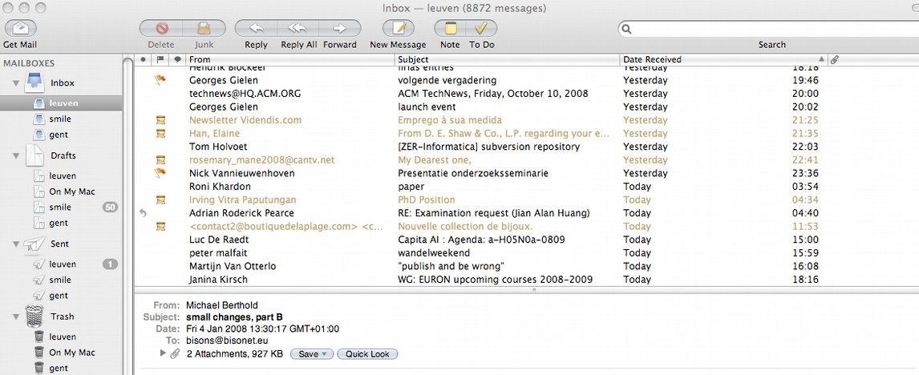
P1: Data Science is a process A simple workflow
Business understanding
SPAM email reduces productivity, automatically remove it

Slide 19
P1: Data Science is a process A simple workflow
Data understanding
Collect messages, in general and from the user, that are spam (negative) and legitimate (positive)
Given a text message, predict whether it is spam or not
→ text categorization, useful in general
→ we want a function from message to {0,1}
→ is called binary classification problem

Slide 20
P1: Data Science is a process A simple workflow
Data preparation
Given a raw text, convert string data into numerical data one
· Bag of words, TFIDF, Word2Vec
Text Preprocessing
Remove Noisy Data: header,footer, HTML,XML,markup data
Tokenization
Normalization

Slide 21
P1: Data Science is a process A simple workflow
Modeling
We could write a rule-based system, such as
if Title.contains(“YOU HAVE WON!!!”) then return Spam
train a classifier (e.g. naïve bayes)
Does it work well? → evaluate

Slide 22
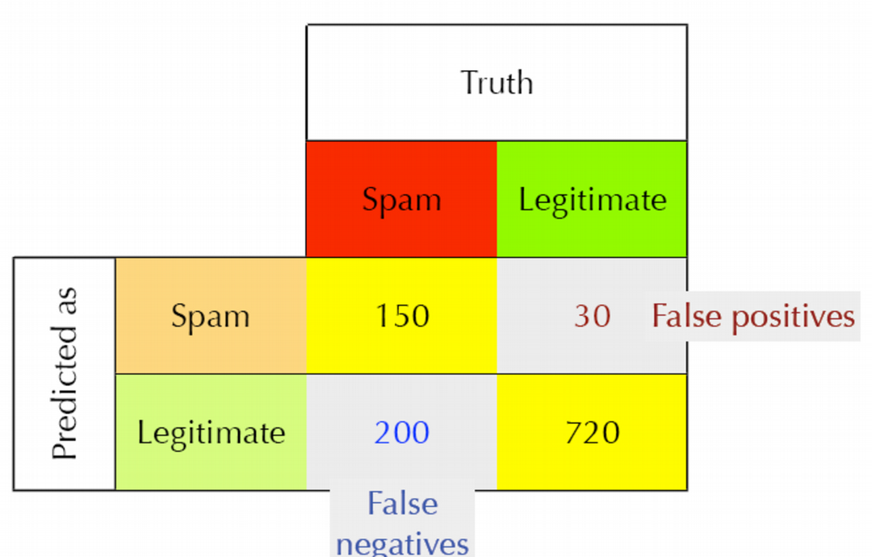
P1: Data Science is a process A simple workflow
Evaluation
on unseen emails

Slide 23
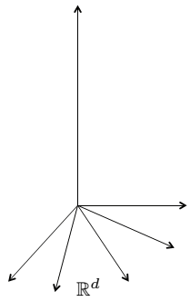
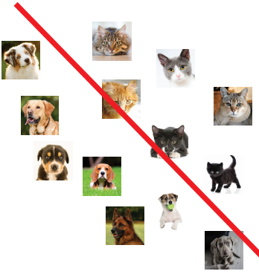
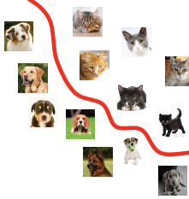
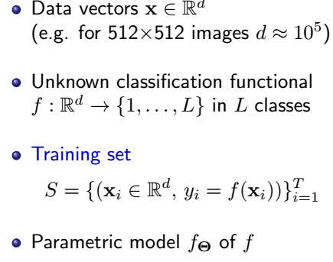
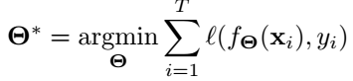
P2: Machine learning is optimization

Slide 24
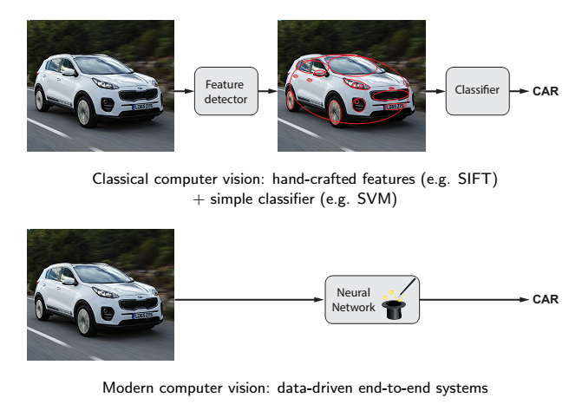
P2: Machine learning is optimization

Slide 25
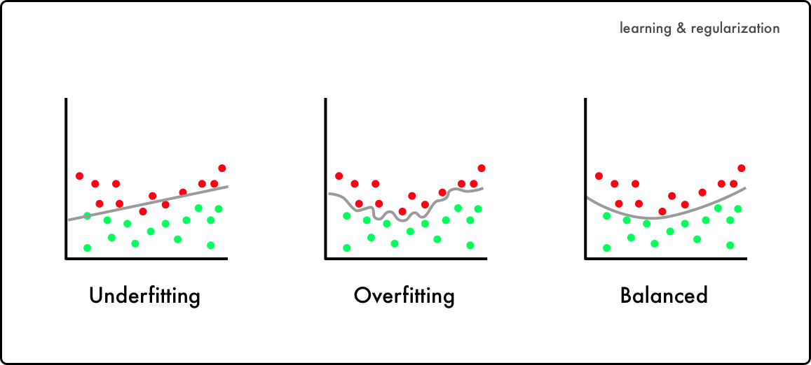
P2: Generalizing
If you look too hard at a dataset, you'll find things that don't generalize to unseen data
Overfitting

Slide 26
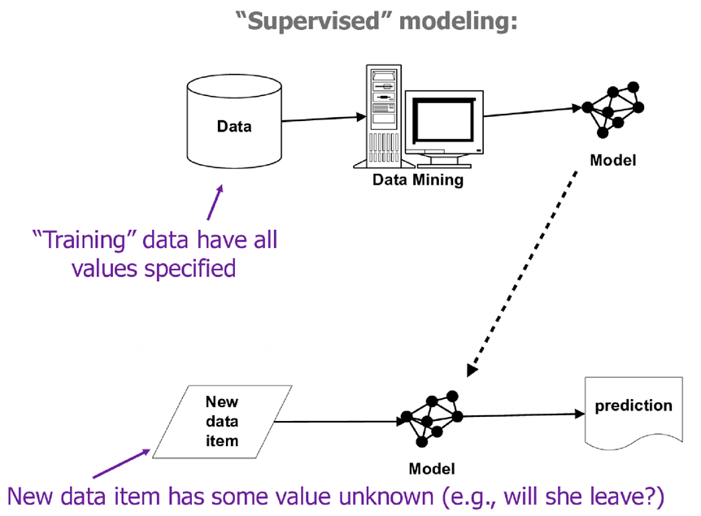
P3: Data science needs to be evaluated in the context of operation
Training data is not consistent with actual use
Bad sample
Bad features

Slide 27
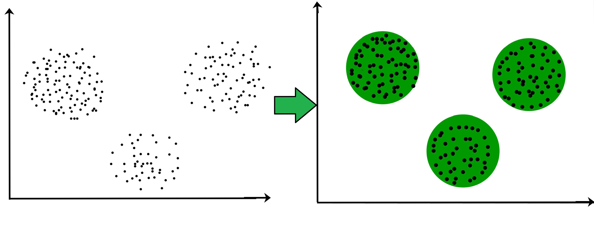
P4: Entities that are similar on some attributes often are similar on unseen attributes
Clustering
Also optimization, e.g. min. distances to cluster center
Key concept: distance between objects
Euclidean, manhatten, edit distances (strings), Dynamic time warping (temporal sequences), …

Slide 28
P5: Correlation
To draw causal conclusions,
one must pay very close attention to the presence of (possibly unseen) confounding factors
Machine models exploit correlation, NOT causality
Very tempting to inspect model and see “what causes things to be true/false”
E.g. coefficients of linear regression
Y = 20*X1 –12*X2 +300*X3 +99*X4 -299*X5
Which feature has most impact?

Slide 29
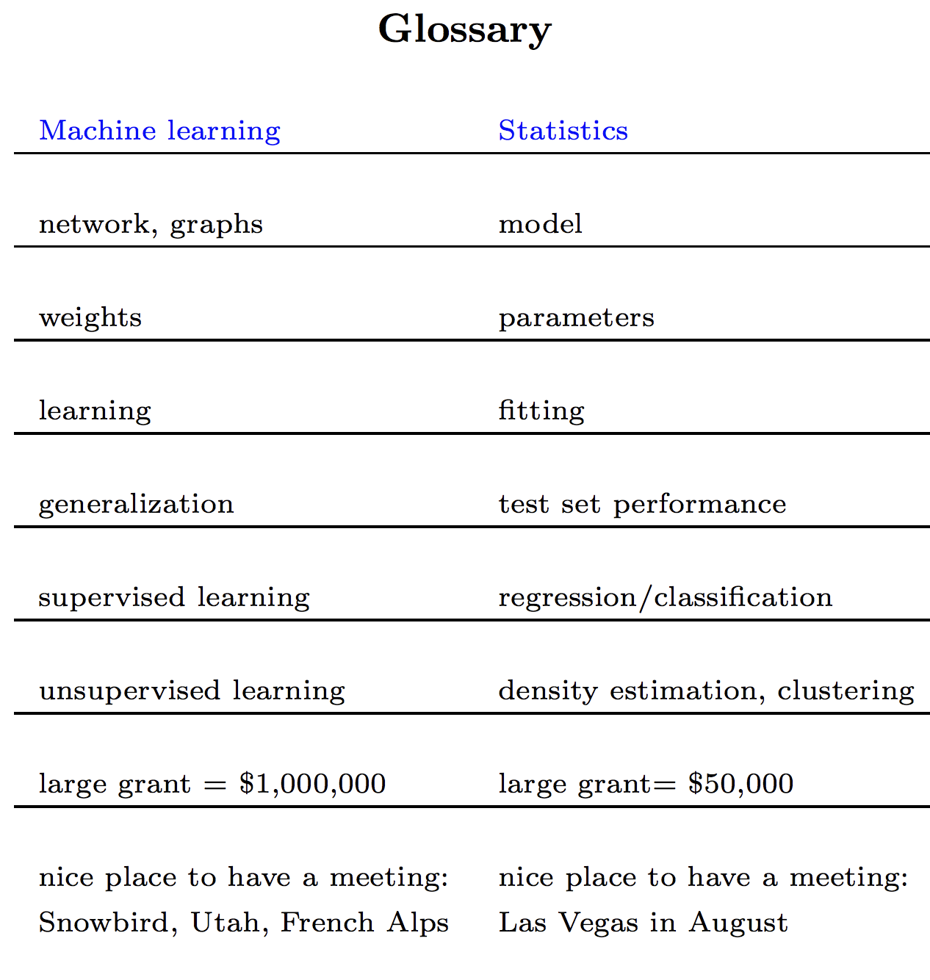
ML vs Stat
In his course on statistics, Rob Tibshirani, a statistician who also has a foot in machine learning, provides a glossary that maps terms in statistics to terms in machine learning, reproduced below.

Slide 30
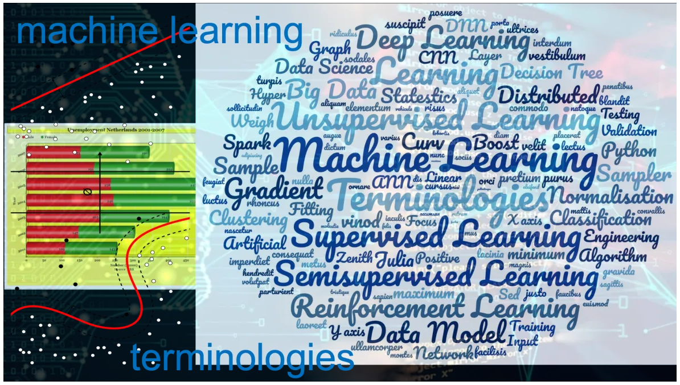
ML terminology

Slide 31
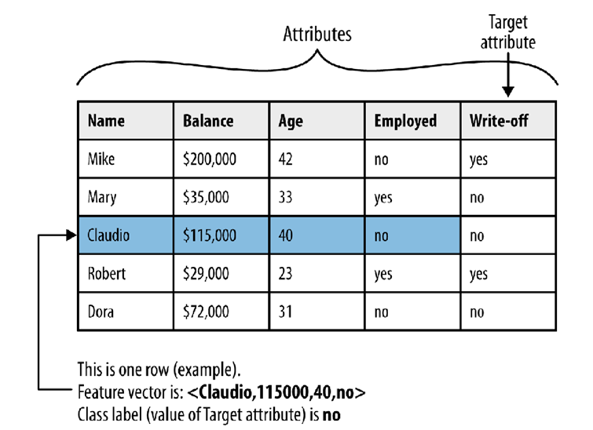
ML Terminology

Slide 32
ML Terminology
Attribute (field, variable, feature)
A quantity describing an instance. An attribute has a domain defined by the attribute type, which denotes the values that can be taken by an attribute. The following domain types are common:
Categorical: A finite number of discrete values. The type nominal denotes that there is no ordering between the values, such as last names and colors. The type ordinal denotes that there is an ordering, such as in an attribute taking on the values low, medium, or high.
Continuous (quantitative): Commonly, subset of real numbers, where there is a measurable difference between the possible values. Integers are usually treated as continuous in practical problems.

Slide 33
ML Terminology
A feature is the specification of an attribute and its value.
For example, color is an attribute. ``Color is blue'' is a feature of an example.
Many transformations to the attribute set leave the feature set unchanged (for example, regrouping attribute values or transforming multi-valued attributes to binary attributes).
Some authors use feature as a synonym for attribute (e.g., in feature-subset selection).
Data set: A schema and a set of instances matching the schema. Generally, no ordering on instances is assumed. Most machine learning work uses a single fixed-format table.

Slide 34
ML Terminology
Instance (example, case, record): A single object of the world from which a model will be learned, or on which a model will be used (e.g., for prediction). In most machine learning work, instances are described by feature vectors; some work uses more complex representations (e.g., containing relations between instances or between parts of instances).

